Slide 1
FYP Presentation
WEB APPLICATION FOR RADIOLOGY INFORMATION SYSTEM
SCE11-0353
Notes:
Title screen

Slide 2
Agenda
Introduction
Design
Implementation
Demonstration
Conclusion
Notes:
Agenda is now finalized

Slide 3
acknowledgment
Dr. Lin Feng
Dr. Vitali
Notes:
Be sure to thank Dr. Lin for giving a lot of freedom during the project

Slide 4
Introduction
Notes:
Slides like these are to let both presenter and audience know where the presentation is

Slide 5
Introduction
Background
Objective
Scope
Resources
Notes:
Sub agenda for introduction section

Slide 6
Background
Traditional healthcare
Paper based
Information systems
Medical information digitized in Hospital Information System (HIS)
Radiology Information System (RIS) is a subsystem of a HIS
eHealth is the future
Notes:
Healthcare has evolved from paper based to IS based
Digitized medical information is stored in HIS, and that RIS is a subsystem of that
With proliferation of broadband, eHealth is the future

Slide 7
Objective
Allow radiologists to:
Work with the system
Retrieve imaging order for referred patients
Store and retrieve medical images
Notes:
Okay to gloss over this quickly

Slide 8
Scope
Visit Radiology Department
Understand workflow
Know jargons
Research DICOM format
Covered later
Learn ASP.NET
Refresh C# knowledge
Learn SQL Server 2008 R2
Design, then develop
Notes:
Okay to gloss over this quickly

Slide 9







resources
Core
Microsoft Visual Studio 2010
Microsoft SQL Server 2008 R2
Add-ons
Ajax Control Toolkit
EO.Web 2011 for ASP.NET
Evil DICOM
Git
ImageResizer
ReSharper
skmValidators
Notes:
Okay to gloss over this quickly

Slide 10
Design
Notes:
Design section proper

Slide 11
Design
Business Domain
DICOM Format
Database Schema Design
Web Application Design
Notes:
Sub agenda for design section

Slide 12
Business domain
Referral
Safe to Proceed?
No
Registration
Physician
Check
Walk-In
Yes
DICOM Images
Take Images
Proceed to Radiology
Database
Diagnosis?
DICOM Images
Physician
Review
Yes
No
Leave
Arrange
Follow-Up
Notes:
Walk through an example workflow from the patient’s viewpoint

Slide 13
DICOm format
Data Set
Preamble
127 bytes of blank data
Prefix
‘D’ ,‘I’ ,‘C’ ,‘M’ identifier
Data Elements
Tag; Group number + Element number
Value Representation (VR); Data type
Value Length (VL)
Value Field (VF); Tag data
E.g. (0010, 0020)
Group number = 0010
Patient
Element number = 0020
Patient name
Notes:
Group number describes an entity
Element number describes the information

Slide 14
DICOm format (CONT.)
Pixel Data
Byte array followed by ‘7FE0 0010’ tag
Looks structured, but lots of inherent issues
Covered later
Header
Data Elem.
Data Elem.
Data Elem.
Pixel Data
Tag
VR
VL
VF
Notes:
A picture speaks a thousand words

Slide 15
Database schema design
Two distinct collections of tables
ASP.NET Membership
Login
Registration
Authentication
Role Management
Business Relation Modelling
Everything else
Linked using referential integrity

Slide 16
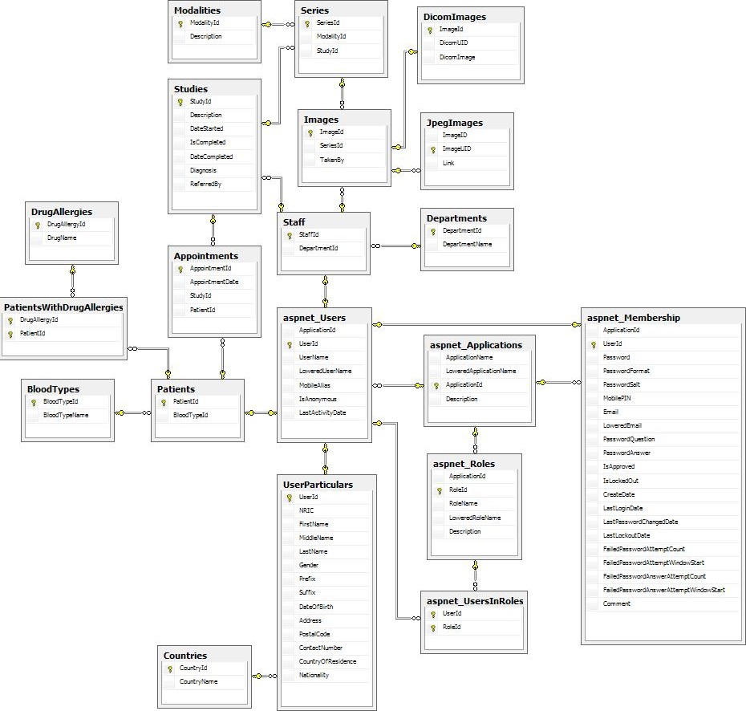
Notes:
Skip everything but the areas to pay attention to

Slide 17
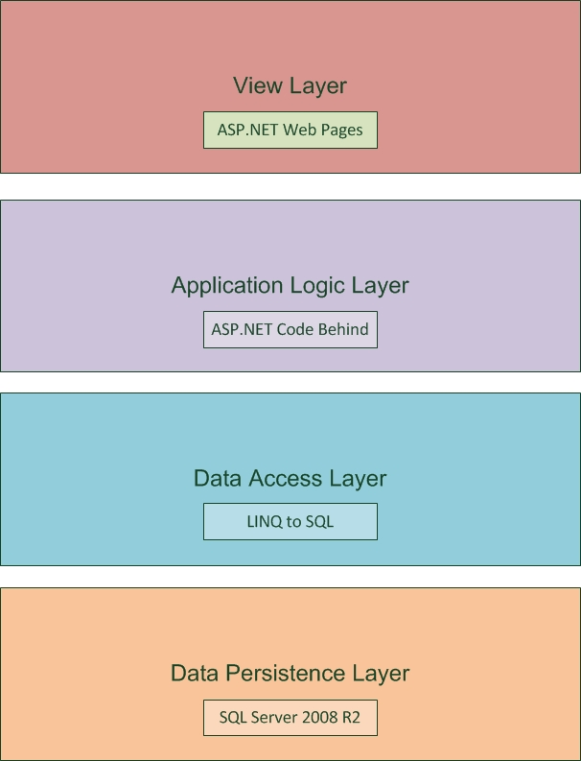
Web application design
Notes:
Talk about separation of concerns and overall design similarity to MVC

Slide 18
Implementation
Notes:
Implementation section proper

Slide 19
Implementation
Unique technical aspects
Database
Application
Notes:
Sub agenda for implementation section

Slide 20

Database
Notes:
Focus the time only on Filestream here

Slide 21
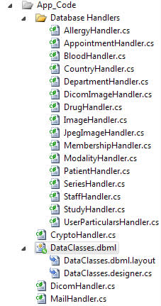
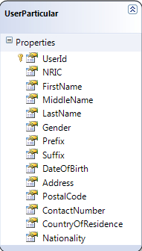
application
Notes:
LINQ to SQL

Slide 22
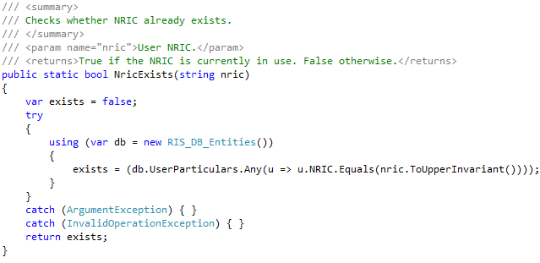
Application (Cont.)
Notes:
LINQ to SQL

Slide 23
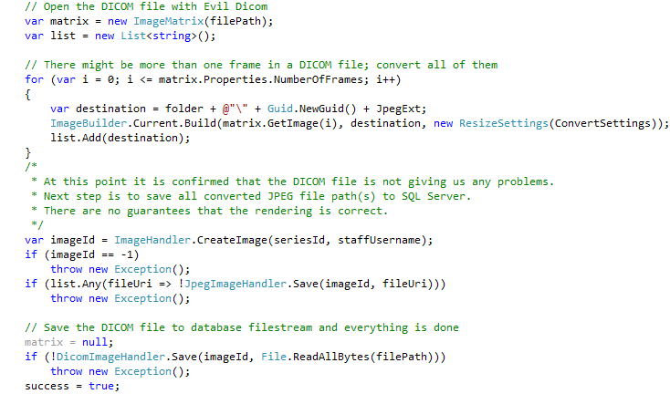
Application (Cont.)
Notes:
Evil DICOM + ImageResizer

Slide 24
demonstration

Slide 25
Conclusion

Slide 26
conclusion
Difficulties Encountered
Future Improvements
Question and Answer

Slide 27
Difficulties encountered
DICOM
Almost everything in header is optional
Endless combinations
Image data encoding not web compatible (e.g. JPEG 2000)
Support for incompatible predecessors (ACR/NEMA)
Little Endian / Big Endian
Evil DICOM

Slide 28
Future Improvements
ASP.NET MVC 3
Easier to manage application complexity
Full control over application behaviour
Ajax
Better user interactivity
jQuery, Telerik Extensions for ASP.NET MVC etc.
Notes:
For each pointer, touch on why it is an advantage over the current implementation.

Slide 29
Future Improvements (CONT.)
DICOM
Evil DICOM not 100% robust
Commercial Vendors
Leadtools, Atalasoft etc.
Open Source Vendors
ClearCanvas
Notes:
For each pointer, touch on why it is an advantage over the current implementation.

Slide 30
Question and answer

